Slide 1
E-Commerce Business – Customer Analysis
Data Visualization
Dr. ShobHani
Shaily prajapati

Slide 2
Analyzing Consumer Data
Allows business to determine current position
Allows businesses to obtain information about specific focus areas
Specific inferences can be made and information about the customer can be obtained
Key focus areas can be determined and processes can be edited to allow for more favorable results

Slide 3
Background
E-Commerce Company selling electronic products online
KPI: Increasing customer satisfaction by reducing customer care calls and increasing on time delivery of shipments and improving customer ratings
Data obtained from company’s CRM system using website and survey data.

Slide 4
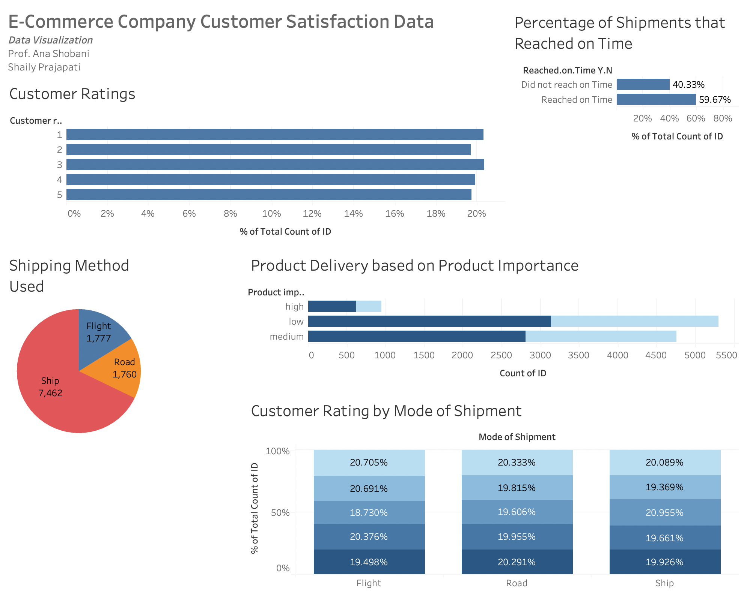
Notes:
https://public.tableau.com/views/TableauFinalreport/Dashboard1?:language=en-US&publish=yes&:display_count=n&:origin=viz_share_link

Slide 5
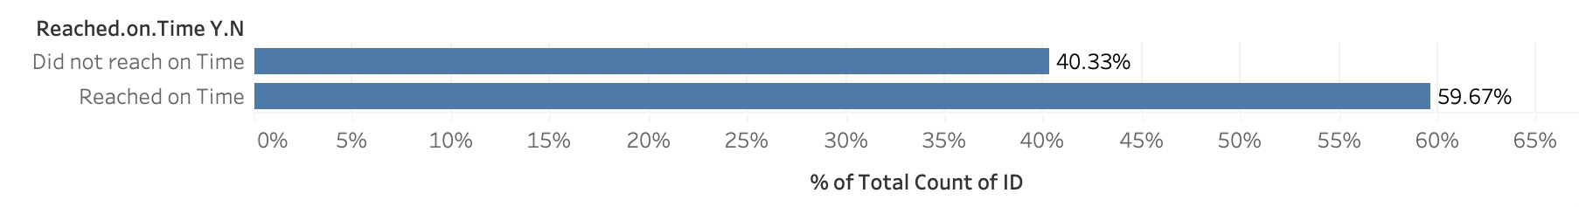
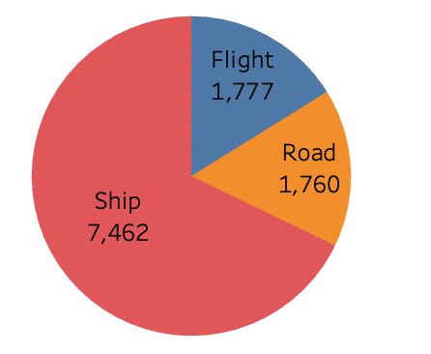
Graphs
Based on these graphs, 40% of deliveries were late and less than 60% of deliveries were on time.
Majority of the shipments were shipped by ship followed by flight and road.

Slide 6
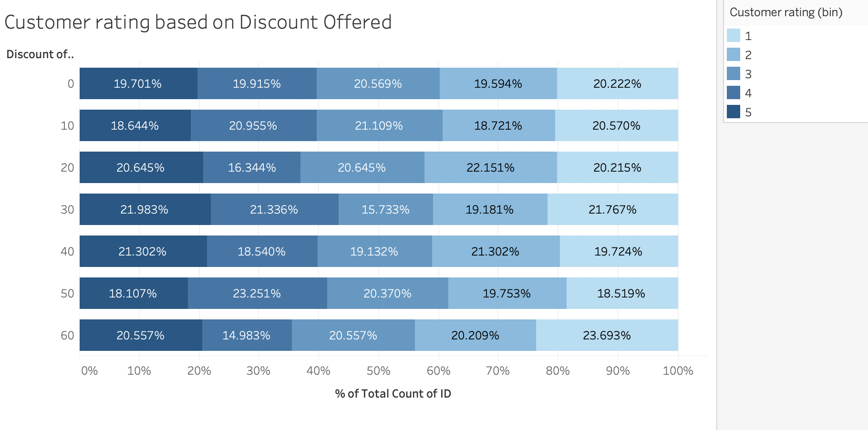
Discounts and Customer Satisfaction
Based on this chart, the highest category we see is that 23% of customers who were offered about 60% discount gave a rating of 1.
Offering customers discount is not proportional to customer ratings.

Slide 7
Conclusion
Shipment metrics are not favorable.
Offering customers discount is not proportional to customer ratings.
The focus area for business is shipping methods and shipping times.
Funds can be reallotted from discounts as higher discounts does not result into higher customer ratings.
This project provides a base for the company to understand where it stands
Additional analysis can be done to determine why these results were obtained taking into considerable additional variables.
Tableau Dashboard link: https://public.tableau.com/views/TableauFinalreport/Dashboard1?:language=en-US&publish=yes&:display_count=n&:origin=viz_share_link

